Slide 1



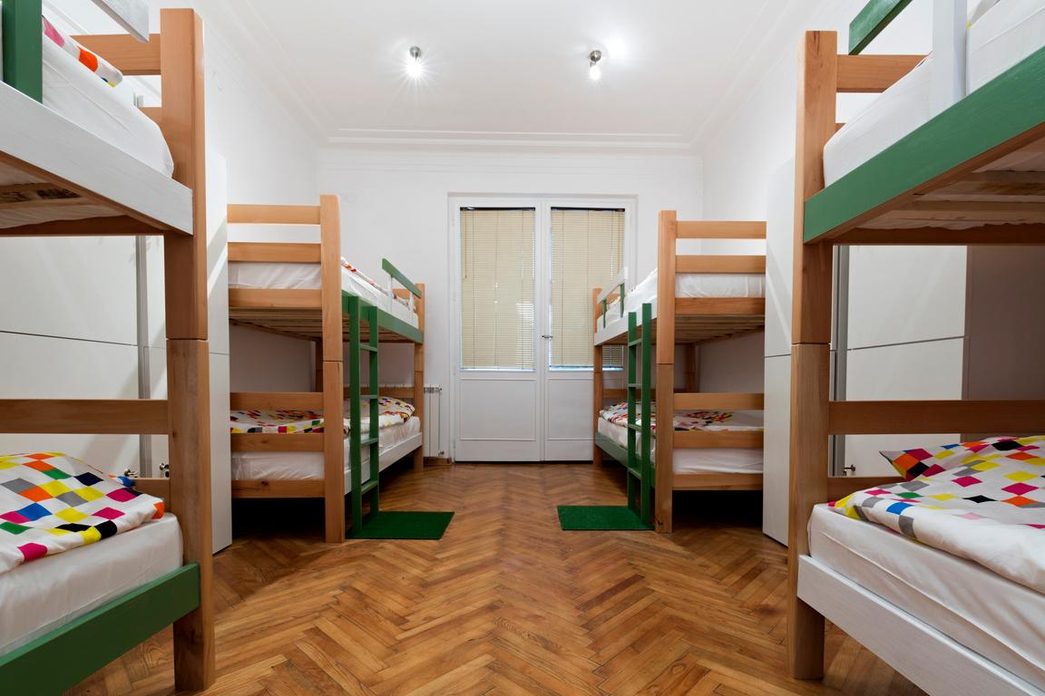



PVSettle
Mid Semester Presentation
Team Mavericks
CINS 5338 - Software Project Management
October, 2023

Slide 2




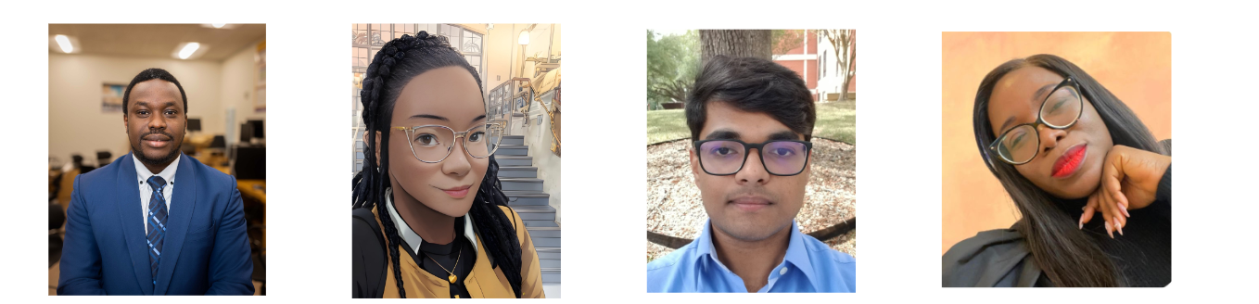
Our T﻿eam
George Ekechukwu
Chinagholum Osasah
Pratyush Srivastava
Oluwayemisi Alabi
Team Lead/Scrum Master
Product Manager
Backend Developer
Frontend & UI

Slide 3







Problem Description
Housing Transition Challenges
Transportation & Mobility
Information Gap
on Essentials
Lack of Community
Insufficient awareness of campus transportation details, including routes, schedules, and fares.
Limited mobility options and difficulties in tracking transportation to nearby stores for essential items.
Absence of detailed information regarding essential living tasks, including opening bank accounts, obtaining Social Security Numbers (SSN), and selecting suitable phone plans.
Lack of comprehensive guidance on crucial aspects of daily life, hindering international students' seamless integration into the new environment.
After implementing the solution, assess its effectiveness. Did it solve the problem as intended? Evaluate the outcomes, both positive and negative. Identify lessons learned and areas for improvement in future problem-solving endeavors
Insufficient details about housing options both on and off campus, including the application procedures, prior to students' arrival.

Slide 4








Impact of Problem
Stress
Financial Strain
Isolation
Loneliness
Academic Difficulties
WL-Balance
Cultural Misunderstanding
Distractions
Limited Mobility
Mavericks| October, 2023

Slide 5


Vision
To create an all-in-one community-driven platform designed to support and empower international students with the essential information, resources, and tools in their transition to Prairie View A&M University.

Slide 6
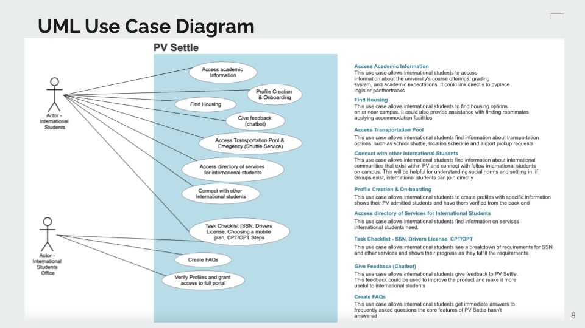

UML UseCase

Slide 7
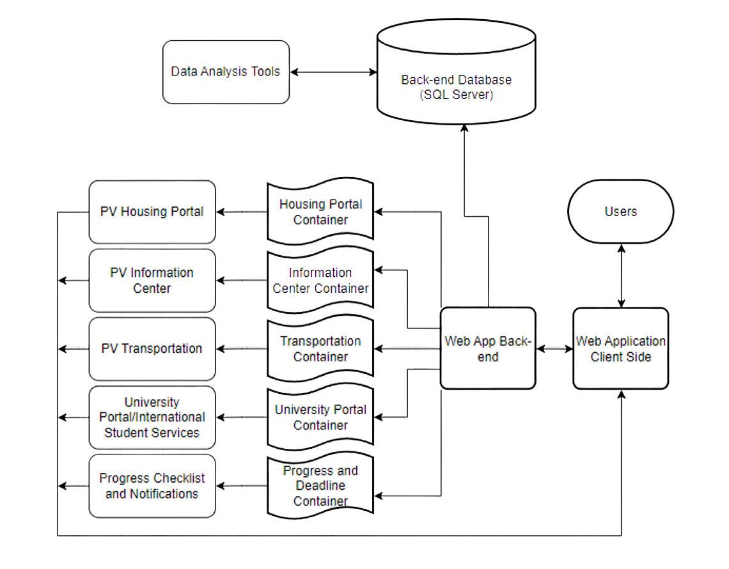

Software Architecture

Slide 8









Main code environment
Server backend and Database
Scrum Software
Source Control and Sharing
Smartphone Emulation for testing
Development Environment

Slide 9
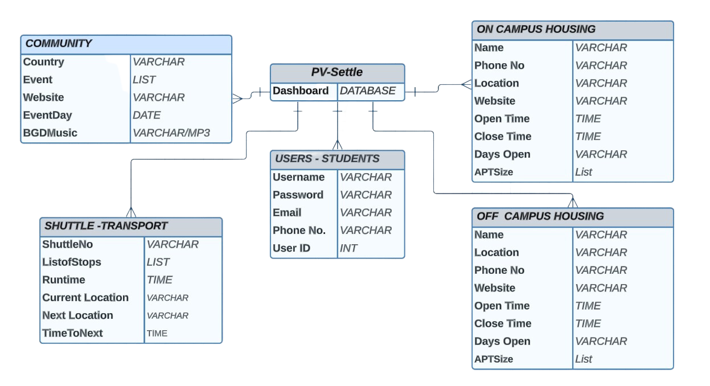
Database Design

Slide 10
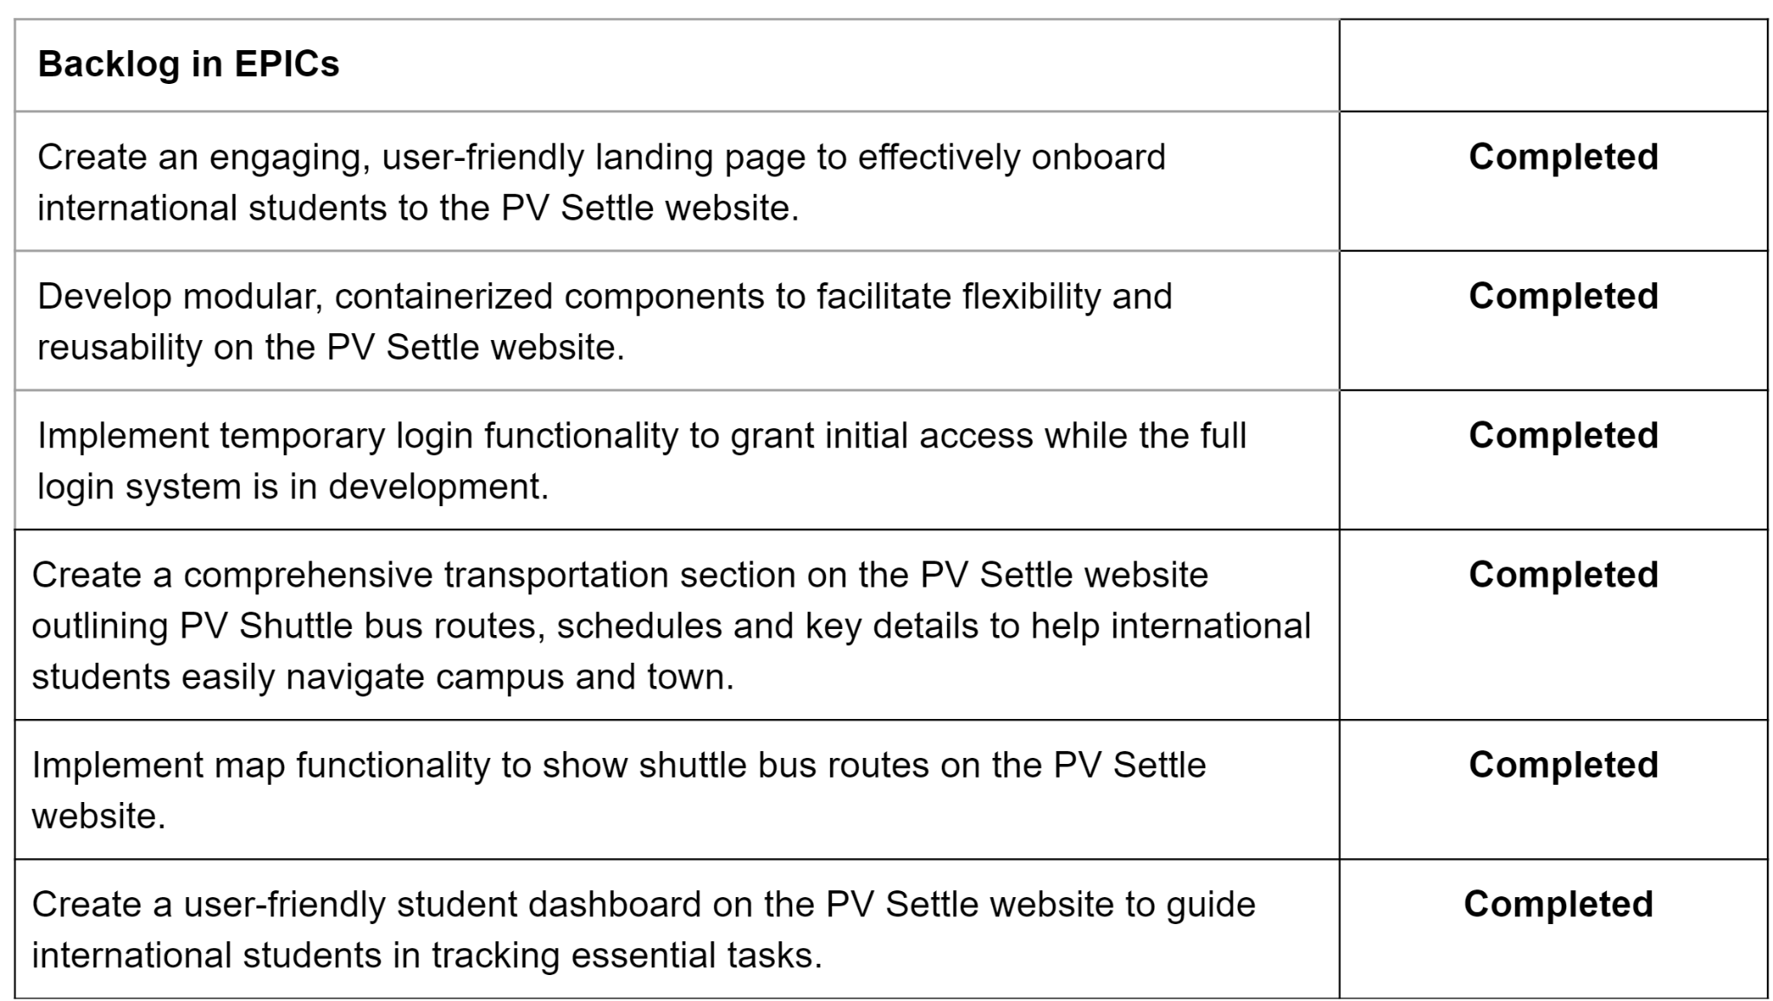
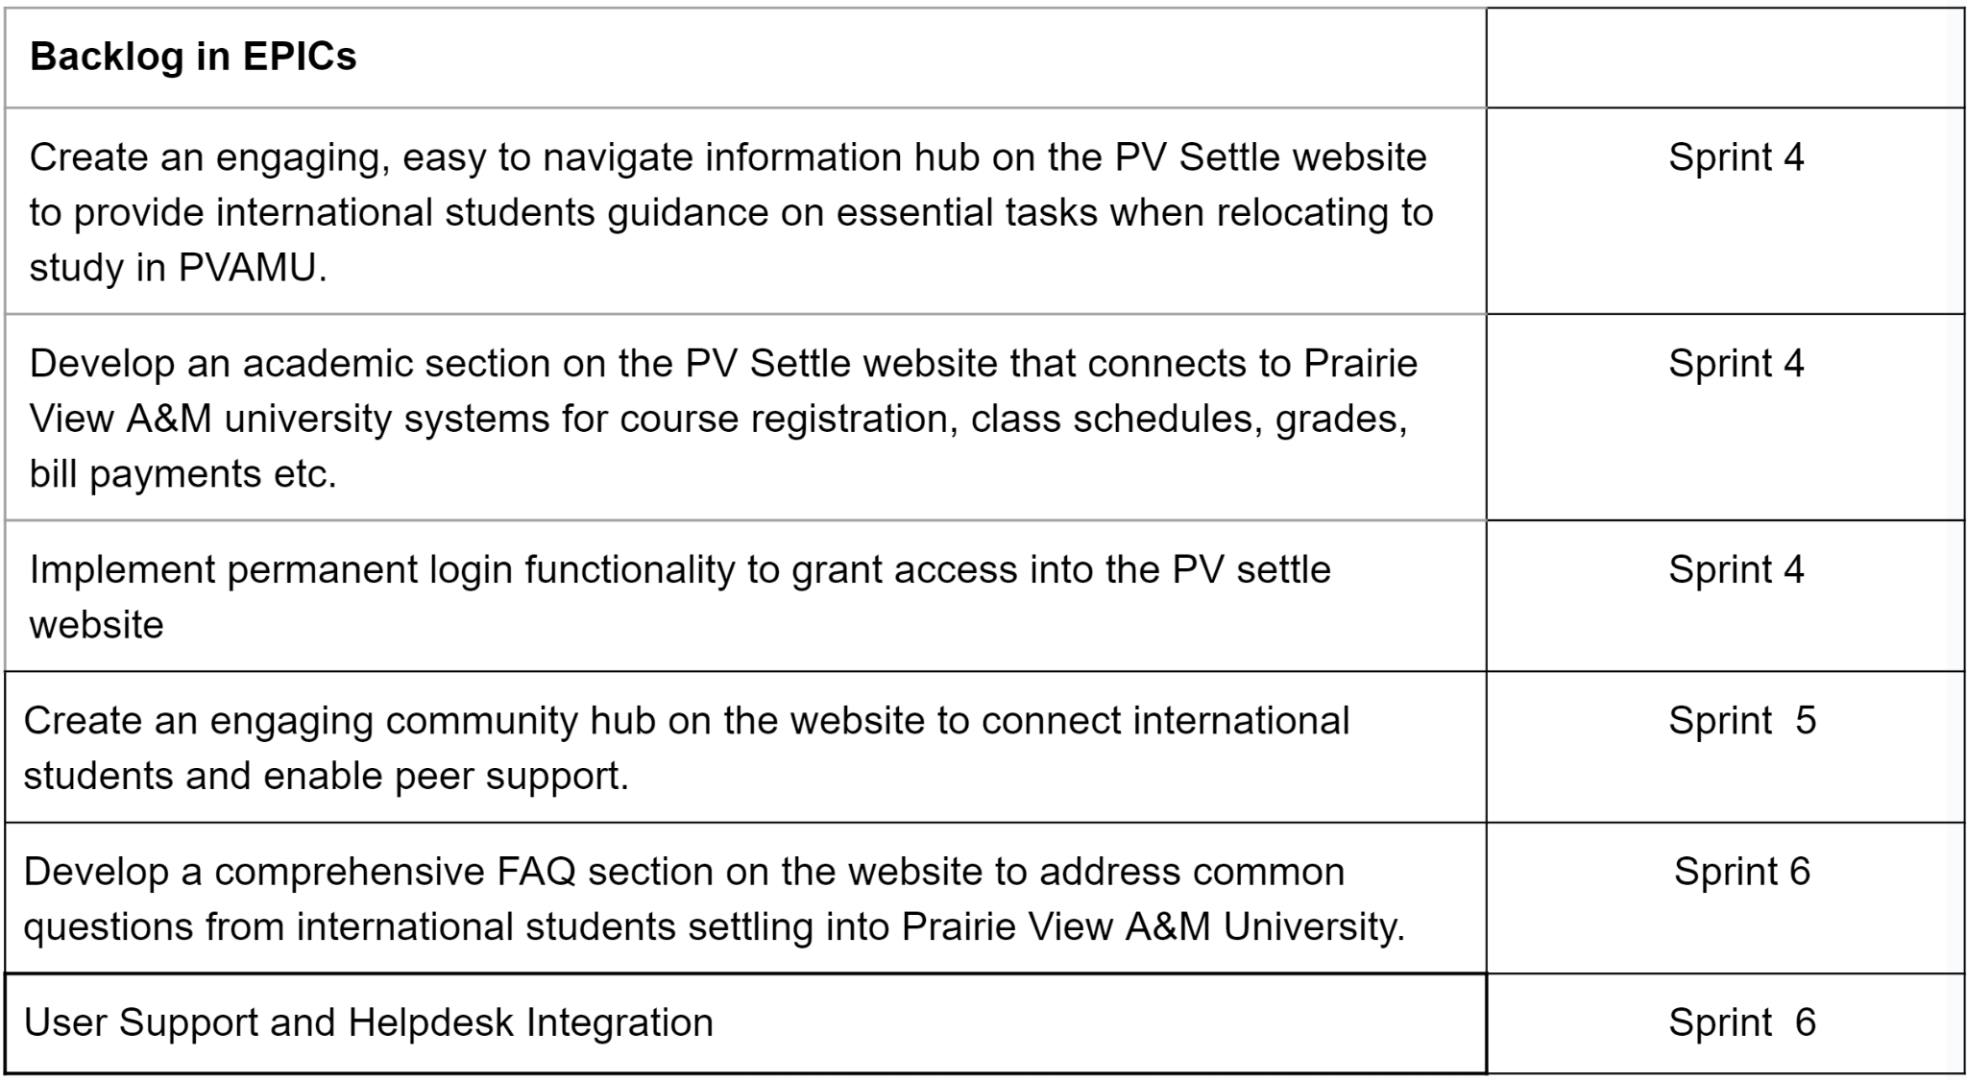

Product Backlog

Slide 11
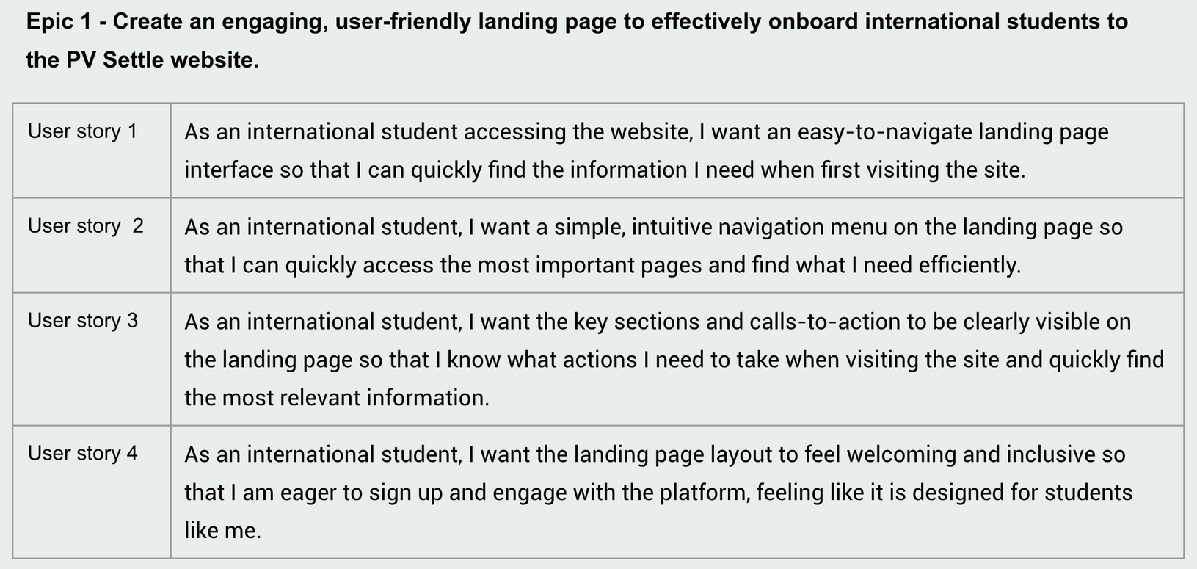

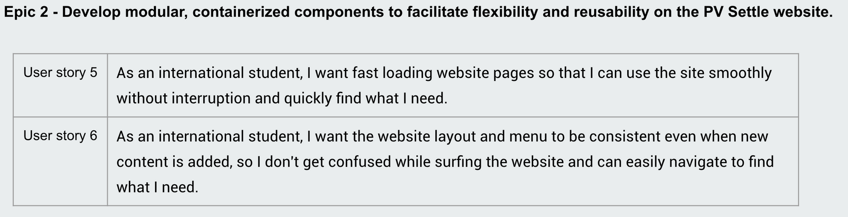
Sprint 1
Completed User Stories

Slide 12
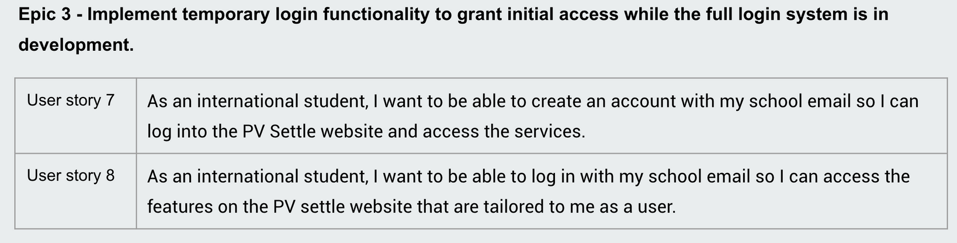
Sprint 1
Completed User Stories

Slide 13
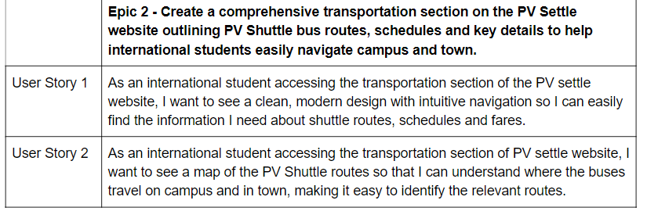
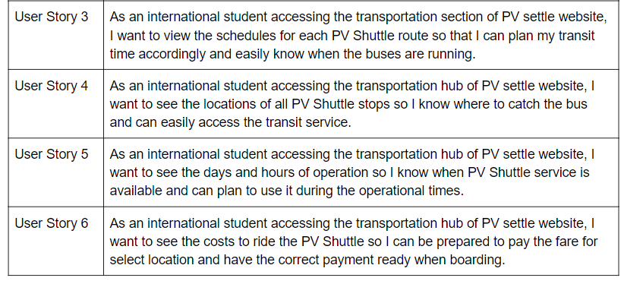
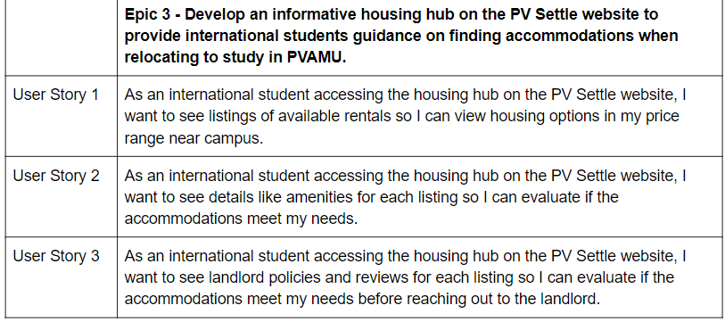
Sprint 2
Completed User Stories

Slide 14
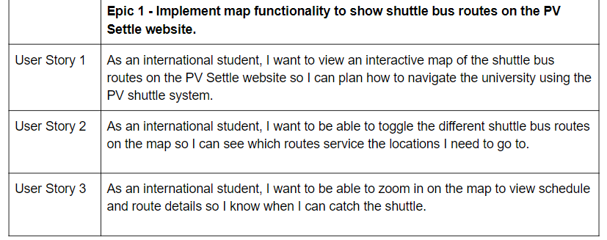
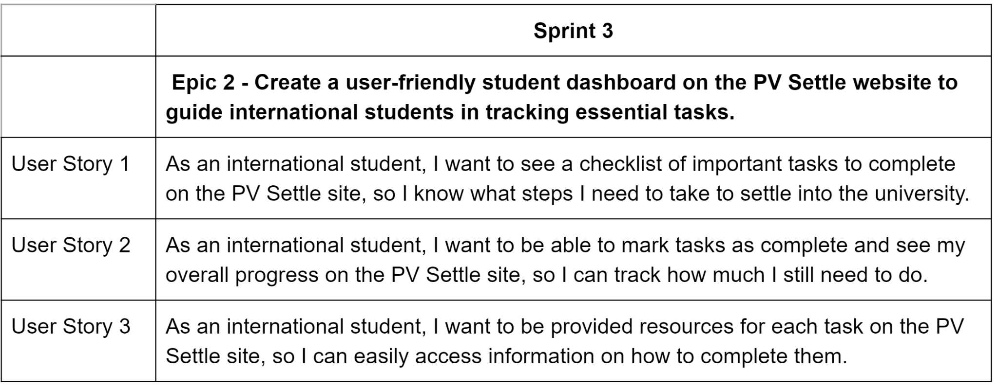
Sprint 3
Completed User Stories

Slide 15



Epic 1 - Create an engaging, easy to navigate information hub on the PV Settle website to provide international students guidance on essential tasks when relocating to study in PVAMU.
Sprint 4
As an international student accessing the PV settle website, I want the information hub organized by clear categories so that I can quickly find the specific guidance I need, making it easy to locate the most relevant information.
As an international student accessing the PV settle website, I want step-by-step instructions for obtaining a social security number so that I can seamlessly navigate the process and succeed in getting this essential ID.
Discussion of Remaining User Stories
As an international student accessing the PV settle website, I want step-by-step instructions for obtaining a phone number so that I can smoothly go through the steps and get connected with phone service when I arrive.
As an international student accessing the PV settle website, I want step-by-step instructions for tasks like opening a bank account so that I can easily complete it without confusion, making the process smooth and straightforward.
As an international student accessing the PV settle website, I want step-by-step instructions for obtaining a phone number so that I can smoothly go through the steps and get connected with phone service when I arrive.

Slide 16
Epic 2 - Develop an academic section on the PV Settle website that connects to Prairie View A&M university systems for course registration, class schedules, grades, bill payments etc.
Epic 3 - Implement permanent login functionality to grant access into the PV settle website.
Sprint 4
Sprint 4
Discussion of Remaining User Stories
As an international student, I want to view my weekly class schedule, room assignments, and professor details so I know when and where my classes meet.
As an international student, I want to be able to create an account with my school email so that I can log into the PV Settle website and access the services.
As an international student, I want to be able to log in with my school email so that I can access the features on the PV settle website that are tailored to me as a user.
As an international student, I want to view and search for courses and create my class schedule for the upcoming semester so I can register for the right classes.
As an international student, I want to be able to logout of my account with my school email so that my profile and usage data is kept private and secure.
As an international student, I want to check my grades for courses and monitor my academic progress so that I can ensure I am meeting program requirements.
As an international student, I want to make tuition and fee payments online via the website so that I can more easily pay my university bills.

Slide 17
Epic 1 - Create an engaging community hub on the website to connect international students and enable peer support.
Sprint 5
As an international student, I want the community hub to have an easy to navigate layout with sections clearly organized by nationality, e.g., Nigeria, India etc., so that I can quickly find and connect with peers from my home country.
As an international student from Nigeria, I want there to be a Nigeria student section in the community hub that is branded with Nigeria colors and design motifs, so that I feel welcomed connecting with other Nigerian students.
Discussion of Remaining User Stories
As an international student, I want each nationality section to showcase important cultural events and holidays, so I don't miss out on key dates.
As an international student, I want to be able to enter my personal details like nationality, interests, hobbies etc. when signing up so that my profile can be created.

Slide 18
Epic 1 - Develop a comprehensive FAQ section on the website to address common questions from international students settling into Prairie View A&M University.
Epic 2 - User Support and Helpdesk Integration.
Sprint 6
Sprint 6
As an international student, I want to search or browse FAQs so that I can find answers to my questions about transitioning to life at the university.
As an international student, I want to access the existing international services help desk through various support channels, such as chat, email, and a support forum, so that I can seek assistance, ask questions, and report platform-related issues efficiently, ensuring a smooth transition into university life.
As an international student, I want the FAQ page to be visually well-organized with clear formatting, so that it is easy to scan and find the information I need quickly.
Discussion of Remaining User Stories
As an international student, I want to view FAQs organized by meaningful categories like housing, transportation, and academics, etc. so that I can easily find relevant information.
As an international student, I want to have quick and convenient access to the help desk's support channels so that I can promptly address any concerns I may have during my transition to university.

Slide 19


Slide 20

Thank You

Slide 21

Questions

